Slide 1

SRM INSTITUTE OF SCIENCE AND TECHNOLOGY
DATA STRUCTURES AND ALGORITHMS (18CSC162J)
UNIT IV

Slide 2
SRM INSTITUTE OF SCIENCE AND TECHNOLOGY
TOPICS TO BE COVERED
INTRODUCTION TO TREE
TREE TRAVERSAL
INTRODUCTION TO TREE
WHAT IS TREE DATA STRUCTURE
WHY TREE DATA STRUCTURE
TREE TERMINOLOGIES
TREE NODE
TYPES OF TREE
TREE TRAVERSAL
APPLICATION OF TREE

Slide 3
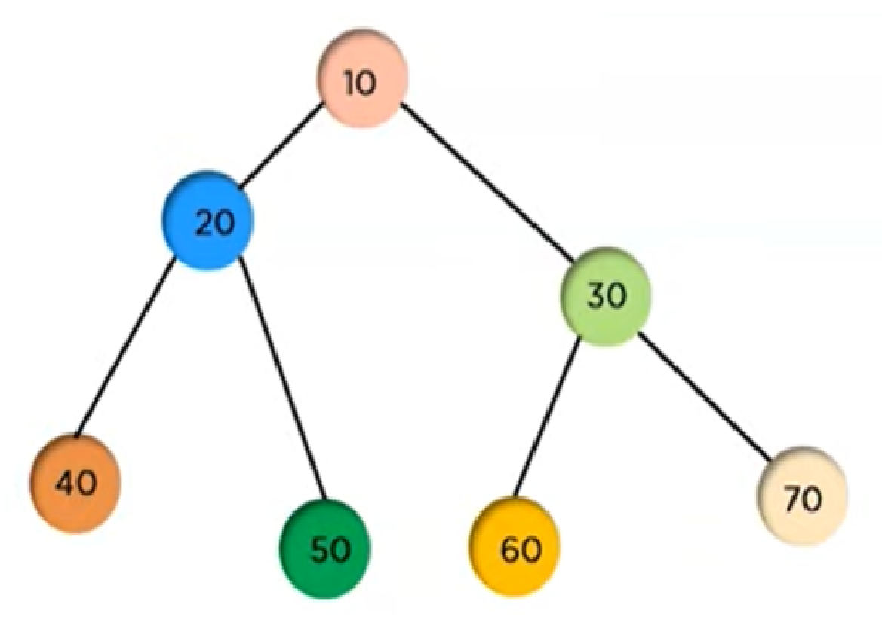
WHAT IS TREE DATA STRUCTURE
SRM INSTITUTE OF SCIENCE AND TECHNOLOGY
THE TREE IS A NON LINEAR DATA STRUCTURE THAT CONSIST OF NODES AND IS CONNECTED BY EDGES.
A TREE DATA STRUCTURE IS A HIERARCHICAL STRUCTURE THAT IS USED TO REPRESENT AND ORGANIZE DATA IN A WAY THAT IS EASY TO NAVIGATE AND SEARCH. IT IS A COLLECTION OF NODES THAT ARE CONNECTED BY EDGES AND HAS A HIERARCHICAL RELATIONSHIP BETWEEN THE NODES.
THE TOPMOST NODE OF THE TREE IS CALLED THE ROOT,
AND THE NODES BELOW IT ARE CALLED THE CHILD NODES.
EACH NODE CAN HAVE MULTIPLE CHILD NODES, AND THESE
CHILD NODES CAN ALSO HAVE THEIR OWN CHILD NODES,
FORMING A RECURSIVE STRUCTURE.

Slide 4
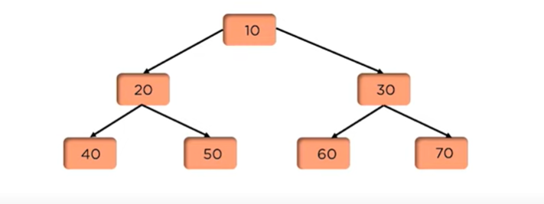
WHY TREE DATA STRUCTURE
SRM INSTITUTE OF SCIENCE AND TECHNOLOGY

Slide 5
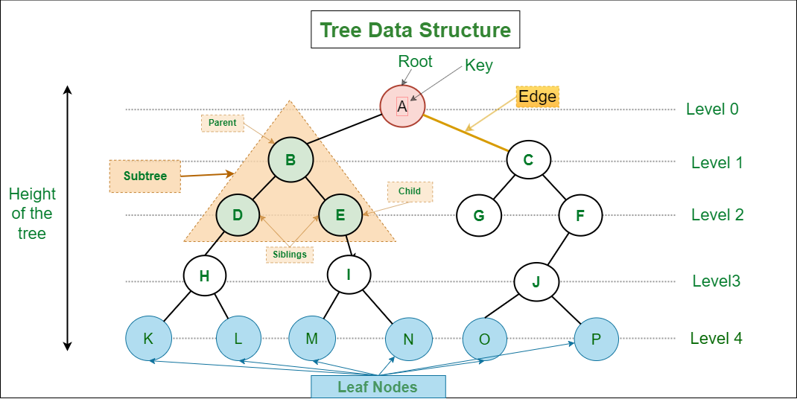
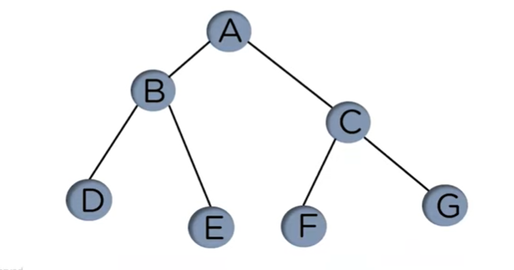
TREE TERMINOLOGIES
SRM INSTITUTE OF SCIENCE AND TECHNOLOGY

Slide 6
BASIC TERMINOLOGIES IN TREE DATA STRUCTURE:
SRM INSTITUTE OF SCIENCE AND TECHNOLOGY
PARENT NODE: THE NODE WHICH IS A PREDECESSOR OF A NODE IS CALLED THE PARENT NODE OF THAT NODE. {B} IS THE PARENT NODE OF {D, E}.
CHILD NODE: THE NODE WHICH IS THE IMMEDIATE SUCCESSOR OF A NODE IS CALLED THE CHILD NODE OF THAT NODE. EXAMPLES: {D, E} ARE THE CHILD NODES OF {B}.
ROOT NODE: THE TOPMOST NODE OF A TREE OR THE NODE WHICH DOES NOT HAVE ANY PARENT NODE IS CALLED THE ROOT NODE. {A} IS THE ROOT NODE OF THE TREE. A NON-EMPTY TREE MUST CONTAIN EXACTLY ONE ROOT NODE AND EXACTLY ONE PATH FROM THE ROOT TO ALL OTHER NODES OF THE TREE.
LEAF NODE OR EXTERNAL NODE: THE NODES WHICH DO NOT HAVE ANY CHILD NODES ARE CALLED LEAF NODES. {K, L, M, N, O, P} ARE THE LEAF NODES OF THE TREE.
ANCESTOR OF A NODE: ANY PREDECESSOR NODES ON THE PATH OF THE ROOT TO THAT NODE ARE CALLED ANCESTORS OF THAT NODE. {A,B} ARE THE ANCESTOR NODES OF THE NODE {E}
DESCENDANT: ANY SUCCESSOR NODE ON THE PATH FROM THE LEAF NODE TO THAT NODE. {E,I} ARE THE DESCENDANTS OF THE NODE {B}.
SIBLING: CHILDREN OF THE SAME PARENT NODE ARE CALLED SIBLINGS. {D,E} ARE CALLED SIBLINGS.
LEVEL OF A NODE: THE COUNT OF EDGES ON THE PATH FROM THE ROOT NODE TO THAT NODE. THE ROOT NODE HAS LEVEL 0.
INTERNAL NODE: A NODE WITH AT LEAST ONE CHILD IS CALLED INTERNAL NODE.
NEIGHBOUR OF A NODE: PARENT OR CHILD NODES OF THAT NODE ARE CALLED NEIGHBORS OF THAT NODE.
SUBTREE: ANY NODE OF THE TREE ALONG WITH ITS DESCENDANT.
REPRESENTATION OF TREE DATA STRUCTURE:
A TREE CONSISTS OF A ROOT, AND ZERO OR MORE SUBTREES T1, T2, … , TK SUCH THAT THERE IS AN EDGE FROM THE ROOT OF THE TREE TO THE ROOT OF EACH SUBTREE.

Slide 7
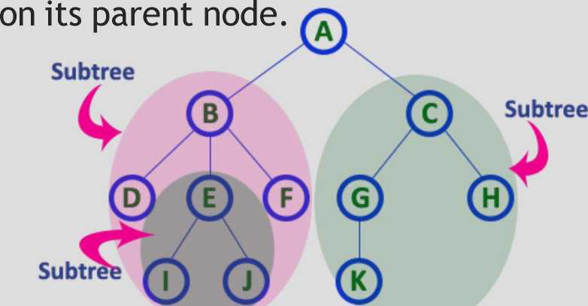
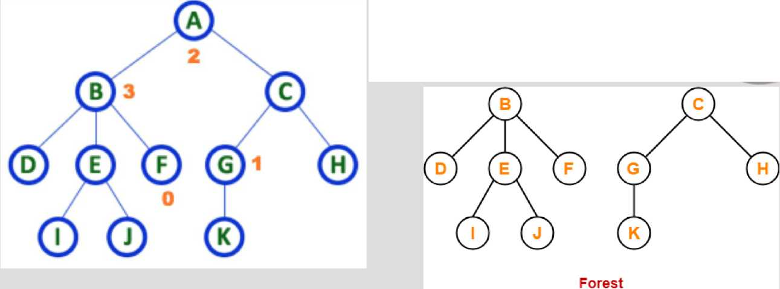
TERMINOLOGIES
SRM INSTITUTE OF SCIENCE AND TECHNOLOGY
The total number of children of a node is called as DEGREE of that Node.
The highest degree of a node among all the nodes in a tree is called as 'Degree of Tree'
Each child from a node forms a subtree recursively. Every child node will form a subtree

Slide 8
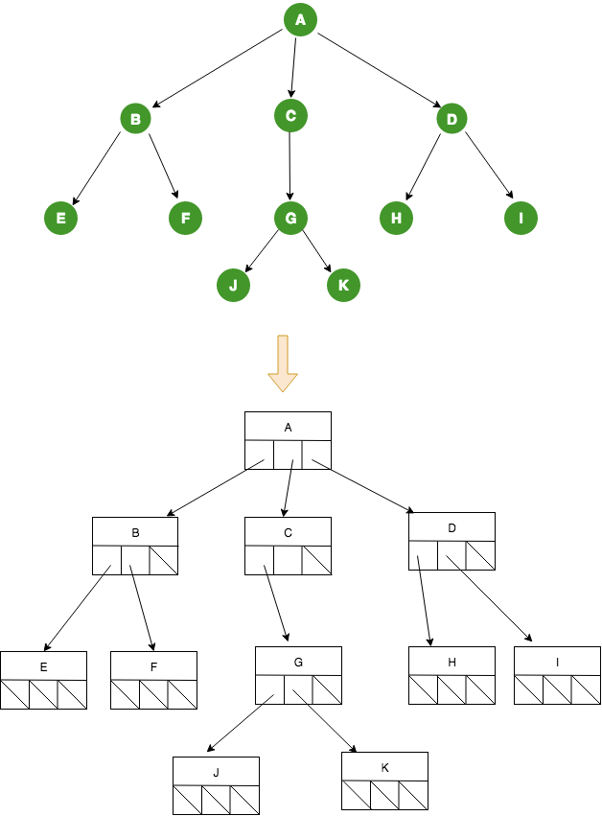
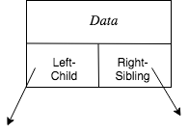
TREE REPRESENTATION
SRM INSTITUTE OF SCIENCE AND TECHNOLOGY
A TREE DATA STRUCTURE WITH A NODE CONTAINING DATA AND POINTER TO EACH CHILD
typedef struct tree_node *tree_ptr;
struct tree_node
{ element_type element;
*tree_ptr;
tree_ptr left;
tree_ptr right; };
typedef tree_ptr TREE

Slide 9
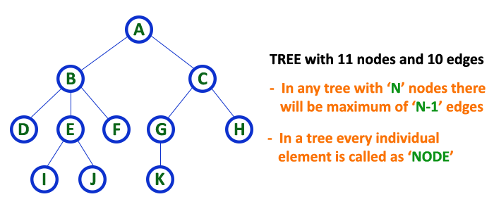
TREE REPRESENTATIONS
SRM INSTITUTE OF SCIENCE AND TECHNOLOGY
A TREE DATA STRUCTURE CAN BE REPRESENTED IN TWO METHODS. THOSE METHODS ARE AS FOLLOWS.
LIST REPRESENTATION
LEFT CHILD - RIGHT SIBLING REPRESENTATION

Slide 10
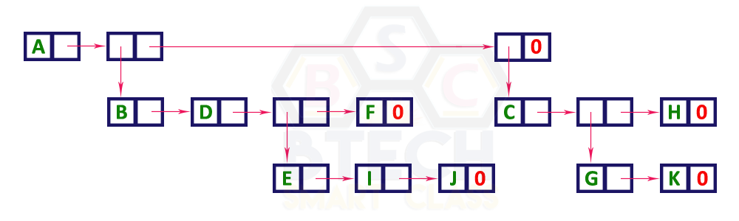
TREE REPRESENTATIONS
SRM INSTITUTE OF SCIENCE AND TECHNOLOGY
1LIST REPRESENTATION
LINKED TO AN INTERNAL NODE THROUGH A 'REFERENCE NODE' WHICH IS FURTHER LINKED TO ANY OTHER NODE DIRECTLY. THIS PROCESS REPEATS FOR ALL THE NODES IN THE TREE.

Slide 11
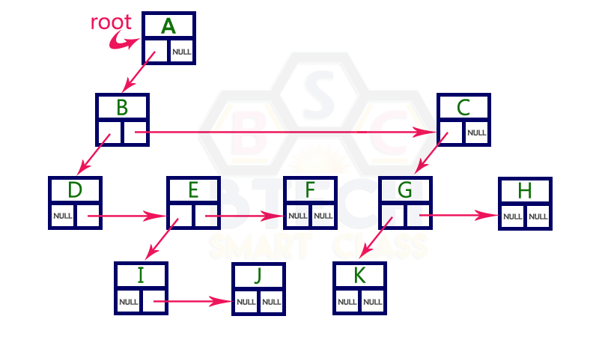
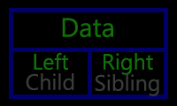
TREE REPRESENTATIONS
SRM INSTITUTE OF SCIENCE AND TECHNOLOGY
LEFT CHILD - RIGHT SIBLING REPRESENTATION
DATA FIELD STORES THE ACTUAL VALUE OF A NODE, LEFT REFERENCE FIELD STORES THE ADDRESS OF THE LEFT CHILD AND RIGHT REFERENCE FIELD STORES THE ADDRESS OF THE RIGHT SIBLING NODE

Slide 12
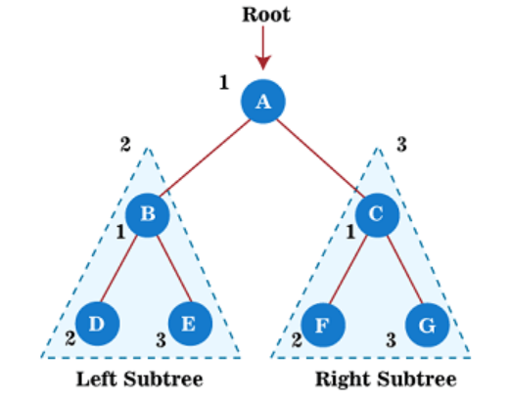
TREE TRAVERSAL
SRM INSTITUTE OF SCIENCE AND TECHNOLOGY
THE TERM 'TREE TRAVERSAL' MEANS TRAVERSING OR VISITING EACH NODE OF A TREE. TRAVERSING CAN BE PERFORMED IN THREE WAYS
PREORDER TRAVERSAL
INORDER TRAVERSAL
POSTORDER TRAVERSAL
PREORDER TRAVERSAL
ALGORITHM
STEP 1 - VISIT THE ROOT NODE
STEP 2 - TRAVERSE THE LEFT SUBTREE RECURSIVELY.
STEP 3 - TRAVERSE THE RIGHT SUBTREE RECURSIVELY.
The output of the preorder traversal of the above tree is -
A → B → D → E → C → F → G

Slide 13
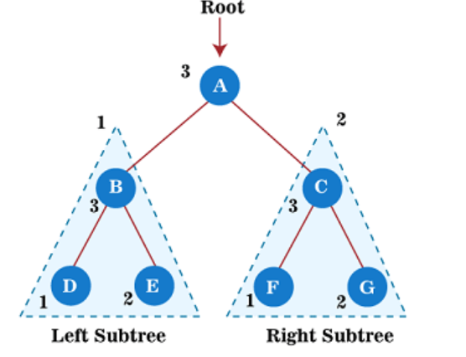
TREE TRAVERSAL
SRM INSTITUTE OF SCIENCE AND TECHNOLOGY
POSTORDER TRAVERSAL
THE FIRST LEFT SUBTREE OF THE ROOT NODE IS TRAVERSED, AFTER THAT RECURSIVELY TRAVERSES THE RIGHT SUBTREE, AND FINALLY, THE ROOT NODE IS TRAVERSED.
ALGORITHM
STEP 1 - TRAVERSE THE LEFT SUBTREE RECURSIVELY.
STEP 2 - TRAVERSE THE RIGHT SUBTREE RECURSIVELY.
STEP 3 - VISIT THE ROOT NODE.
The output of the postorder traversal of the above tree is -
D → E → B → F → G → C → A

Slide 14
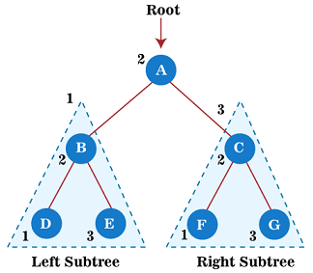
TREE TRAVERSAL
SRM INSTITUTE OF SCIENCE AND TECHNOLOGY
INORDER TRAVERSAL
THE FIRST LEFT SUBTREE IS VISITED AFTER THAT ROOT NODE IS TRAVERSED, AND FINALLY, THE RIGHT SUBTREE IS TRAVERSED.
ALGORITHM
STEP 1 - TRAVERSE THE LEFT SUBTREE RECURSIVELY.
STEP 2 - VISIT THE ROOT NODE.
STEP 3 - TRAVERSE THE RIGHT SUBTREE RECURSIVELY.
The output of the inorder traversal of the above tree is -
D → B → E → A → F → C → G

Slide 15
APPLICATION OF TREE
SRM INSTITUTE OF SCIENCE AND TECHNOLOGY
Binary search trees are used to quickly check whether an element present in a set or not. Most popular database uses B-tree, which is a variant of the tree data structure Modified version of trees called Tries is used in the router to store routing information. The compiler uses a syntax tree to validate the syntax of every program you write.

